Slide 1
Customer Complaint Analyzer For Small Business
Project 2
Internship Project Using Power BI

Slide 2
Project Objective
This project aims to help a small business understand its customer complaints better. I used data analysis and sentiment tools to find patterns and emotions in the feedback. The dashboard makes it easy to see what’s going wrong and where improvements can be made.
Identify recurring customer issues by analyzing complaint data.
Understand customer sentiment using natural language processing(VADER).
Visualize complaint trends across time, regions, and categories.
Generate actionable insights to help the business improve service quality.
Use Python, MySQL, and Power BI to build the full project from start to finish.

Slide 3
Tools & Technologies
Python Used for cleaning complaint data and analyzing sentiment with VADER.
MySQL Stored structured data for efficient querying and trend analysis.
Power BI Designed interactive dashboards to visualize complaints by time, region, and sentiment.
GitHub Hosted the full project with version control and documentation.

Slide 4
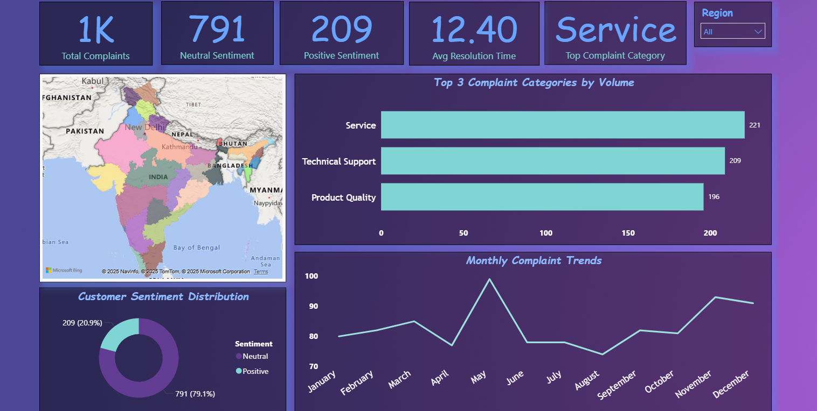
Dashboard Overview
Total Complaints: 1,000
Sentiment Breakdown:
Neutral: 79.1%
Positive: 20.9%
Top Complaint Category: Service
Top 3 Categories:
Service (221)
Technical Support (209)
Product Quality (196)
Region-wise Map: Shows complaint density across India
Monthly Trends: Peaks in May
Avg. Resolution Time: 12.4 days

Slide 5
Insights Summary
Service-related complaints are highest (22.1%)
Neutral sentiment dominates (79.1%)
May saw a spike in complaints — possible seasonal issue
Resolution time averages 12.4 days
Certain regions show higher complaint volume
Neutral sentiment is common in service and support issues

Slide 6
Suggested Actions
Streamline service workflows to reduce recurring complaints focus on top complaint categories like service and support.
Launch targeted feedback campaigns in high-complaint regions engage customers to identify root causes and improve satisfaction.
Monitor resolution time monthly to boost responsiveness set internal benchmarks and track progress over time.
Leverage sentiment trends to guide support tone and training neutral feedback suggests opportunity for empathy-driven communication.

Slide 7
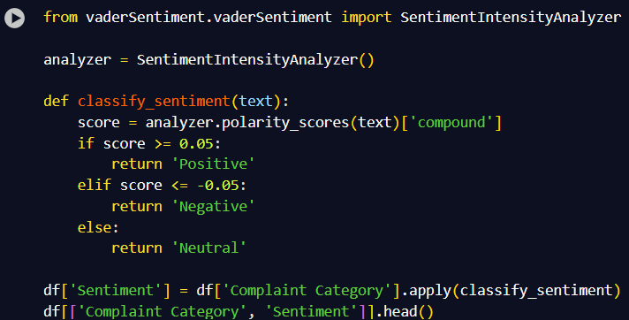
Sentiment Analysis in Python
VADER Sentiment Analysis : •Used the VADER from model from the vaderSentiment library to classify complaint categories into Positive, Negative, or Neutral sentiments.
Data Cleaning Steps :
• Dropped null values.
• Standardized complaint categories using .str.title() and .str.strip().
• Converted Date Filed to datetime format and removed invalid entries.
Code Snippet (Colab)

Slide 8
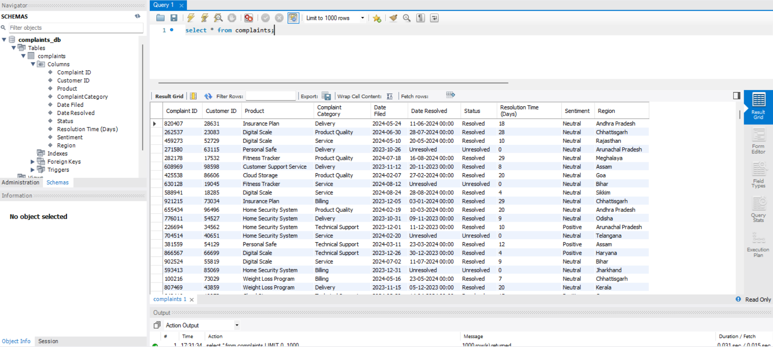
MySQL Database Overview
Complaint data stored in MySQL for structured querying and seamless integration with Python and Power BI.

Slide 9
Conclusion
This dashboard was designed to analyze customer complaints and uncover key pain points across categories and regions.
By visualizing sentiment and complaint trends, it enables quick diagnosis of service issues and supports targeted improvements.
The project demonstrates a complete analytics pipeline, integrating Python for data cleaning and sentiment analysis, MySQL for structured storage, and Power BI for executive-level visualization.
These insights empower businesses to make informed, customer-centric decisions that improve satisfaction and operational efficiency.

Slide 10
Thanks for Reviewing My Internship Project
GitHub Repository :- https://github.com/AnuragPowtshyan/Customer-Complaint-Analyzer-for-Small-Business
Name: Anurag Kumar
Role:- Data Analyst Intern
University:-- Indian Institute of Technology Patna
Internship at: Guvi HCL

